Slide 1
Measurement
EQ: How do we change units so we can find perimeter?

Slide 2
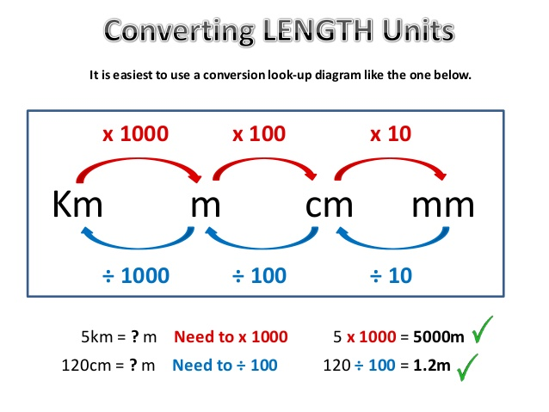
Conversion

Slide 3
Practise
Use your place value chart.

Slide 4
Perimeter
Perimeter is the total length around the outside of a shape.
What does total mean mathematically?
We use it to find how much trimming we need around edges in houses, bathrooms how much fencing material we need.

Slide 5
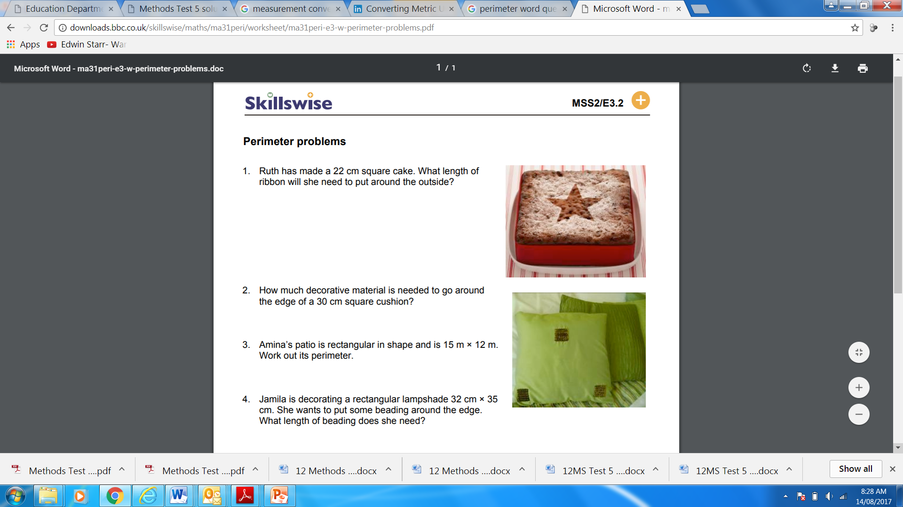
Easy OLNA problems

Slide 6
The tricky part
Make sure all of the units are the same before you add up!!!
Have a go at the quick sheet.

